Slide 1
Robotics Final Project
Sanjit Thippavajjula and Eshaan Perikala Period 6

Slide 2
Planning and Reasearch
To first start working on our project, we needed to compile a list of materials we needed, as well as how we were going to code and assemble the final project. To do this, we used YouTube and past projects, as references.
List of Parts for the Timer: - Arduino Uno
7 Push Buttons
2 LEDs
3 Resistors
LCD Display
Potentiometer
Buzzer
List of Parts for the Orb: - Arduino Nano
8-LED Strip (WS2812)
GY-521 Gyroscope Module (MPU6050)
On/Off Switch
Battery Pack

Slide 3
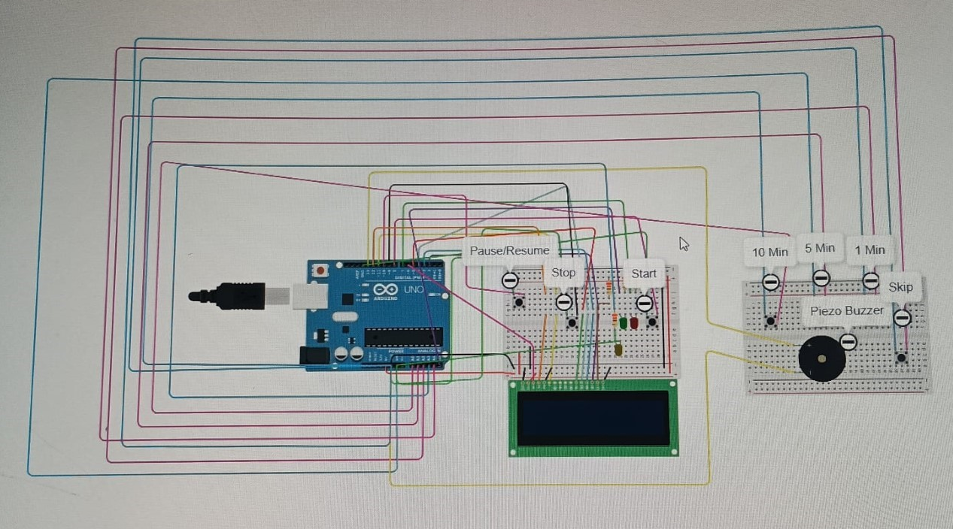
Design and Initial Developments
After choosing our components, we created a model of the timer on TinkerCAD to layout our electronics and test the initial code. We ended up creating a fully working simulation. Unfortunately, TinkerCAD did not any of the main components we needed to create the Orb, so we couldn't make a model online

Slide 4
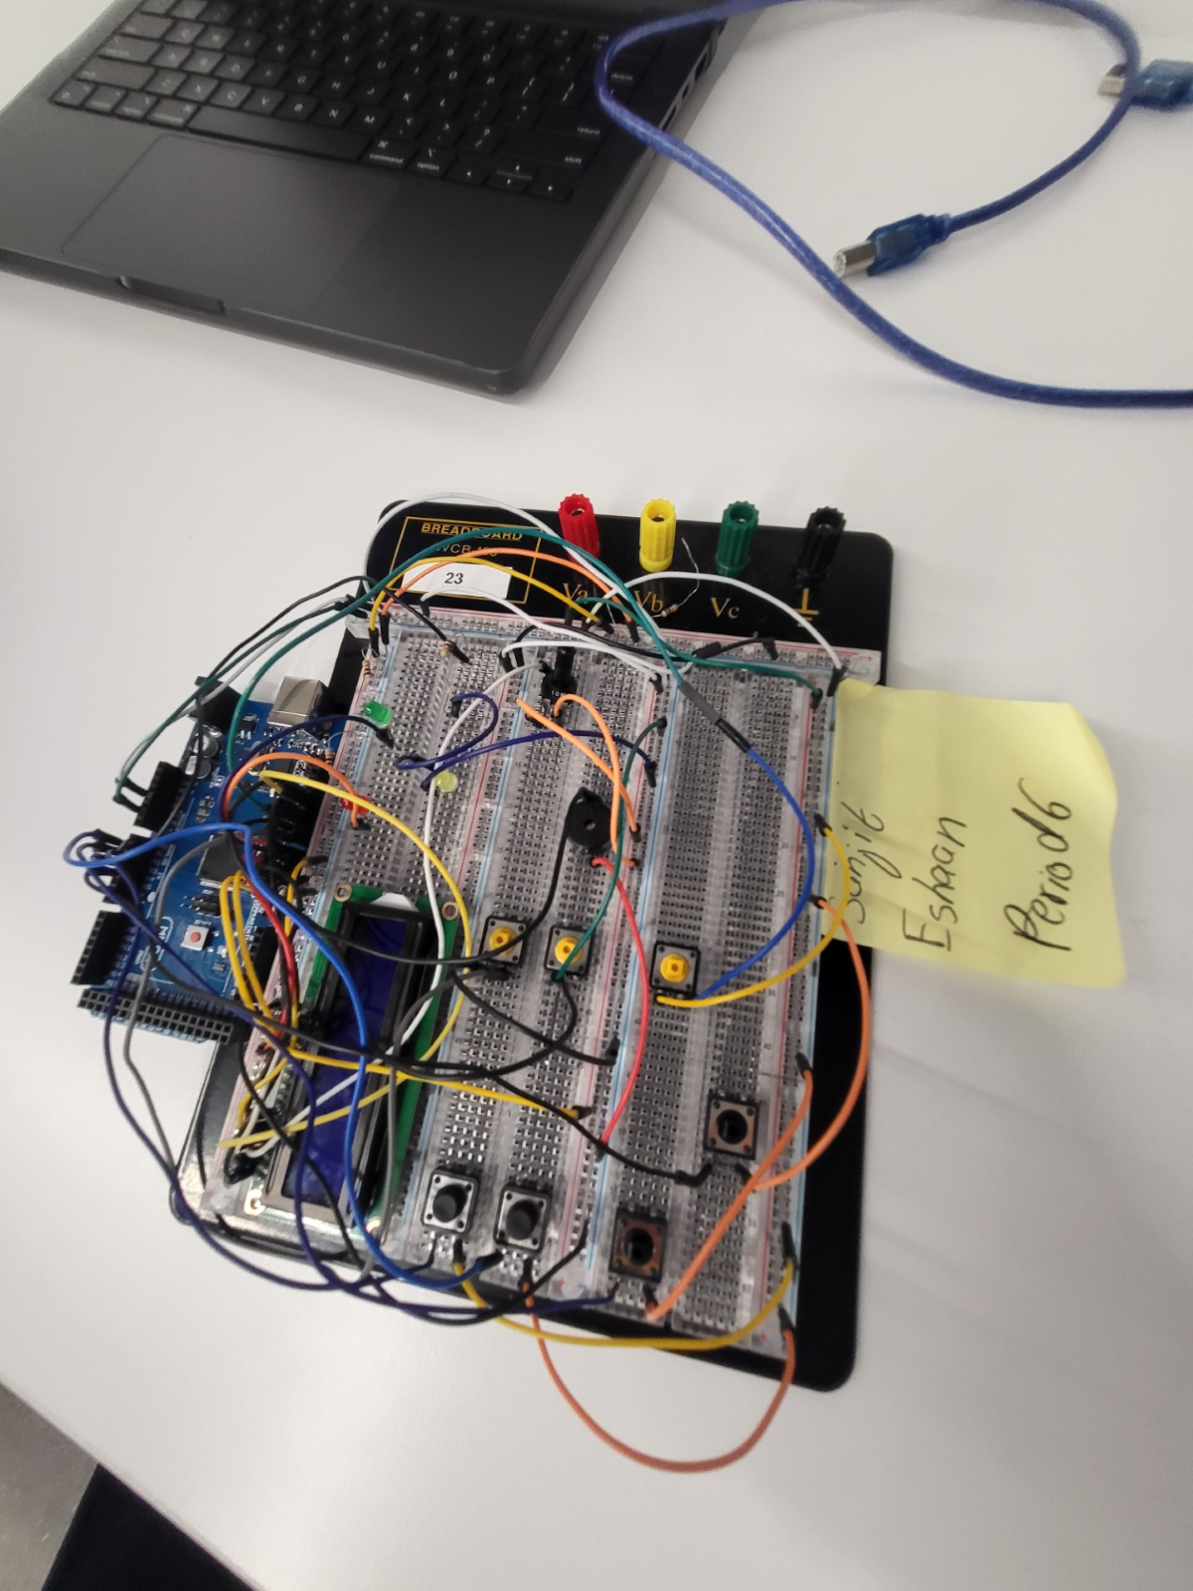
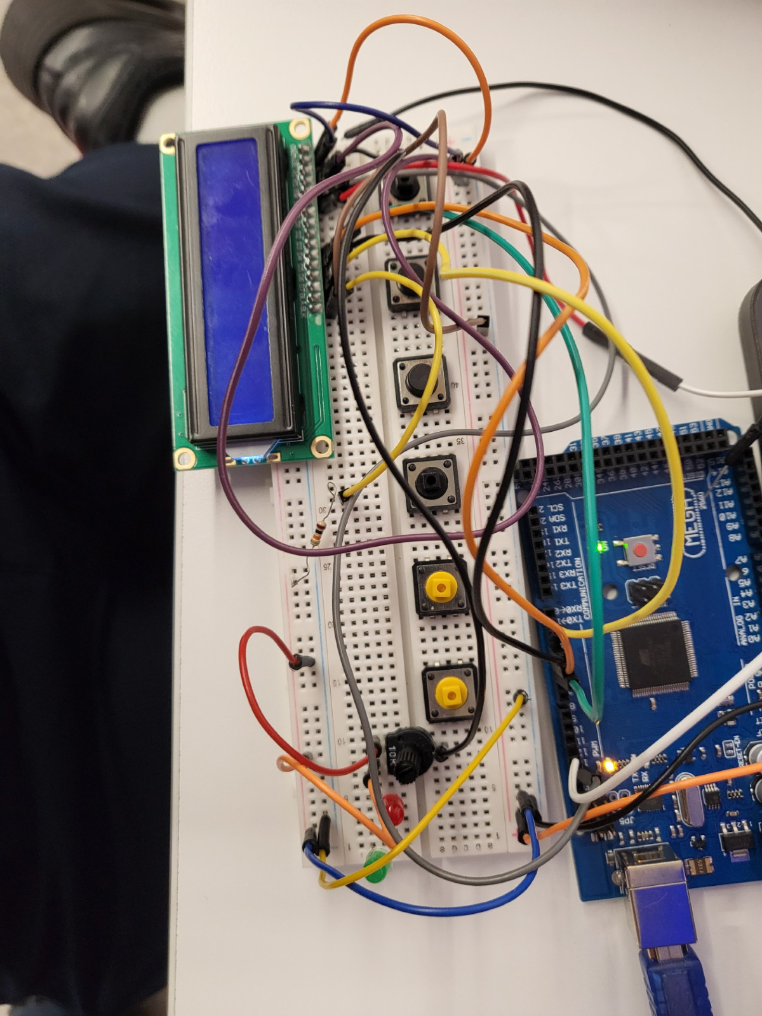
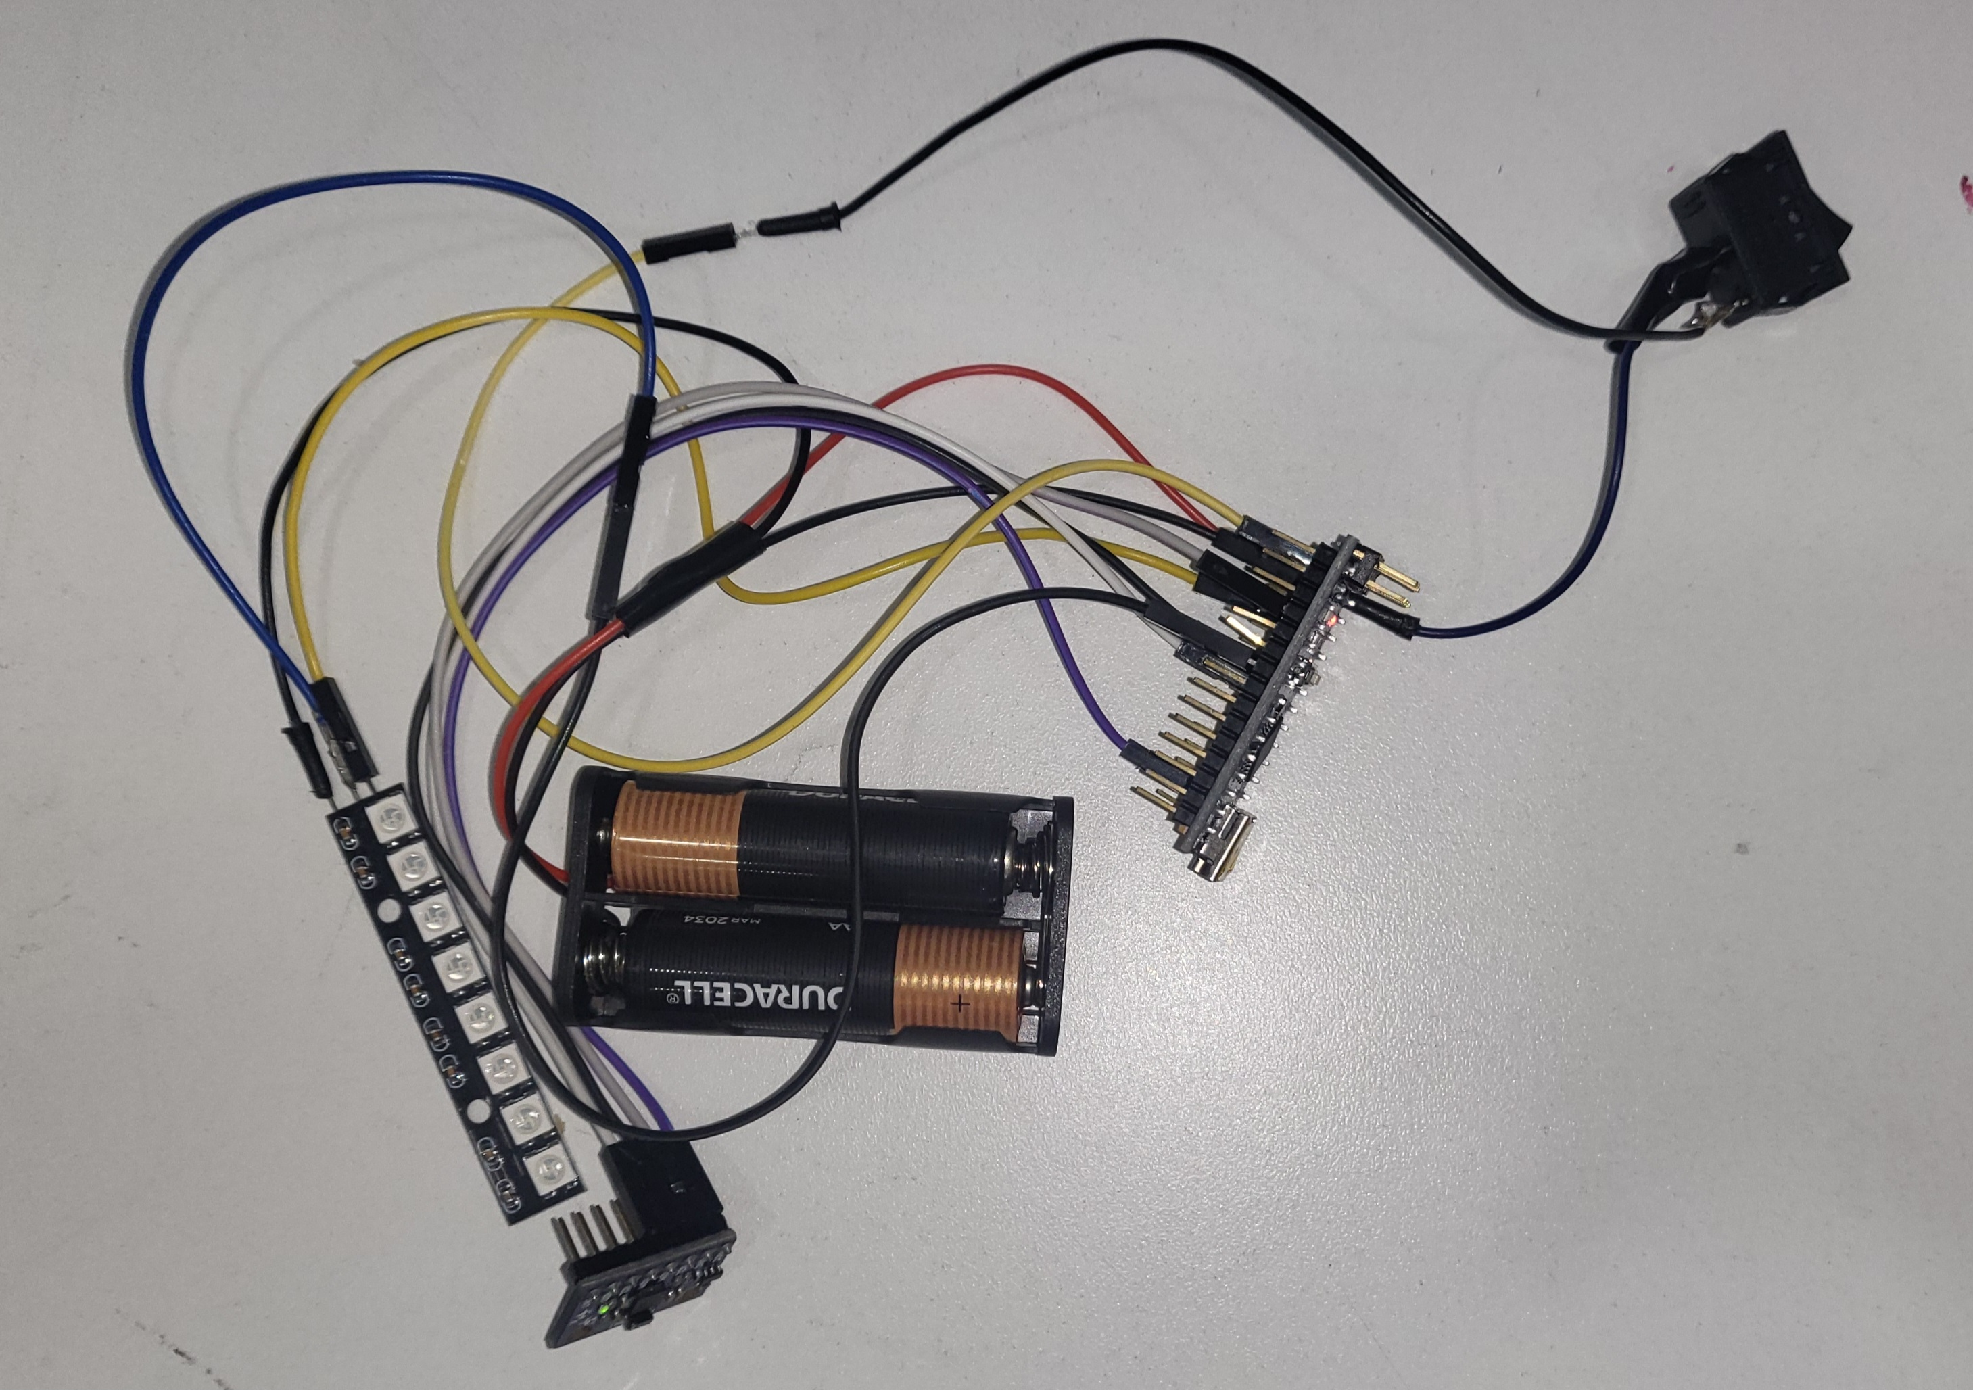
Building, Coding, Testing, Enhancing
After building the circuit for the timer, we had to troubleshoot and test our code multiple times over to make sure our code was working and stayed consistent Compared to the Timer, the Orb was relatively more difficult to build and code, as neither of us had worked with either an Arduino Nano or this type of Gyroscope before.

Slide 5
The Timer
Equipped with 2 LED lights, one which lights during work time and one which lights up for short and long breaks. A Piezo buzzer sounds whenever it is time to switch between work and break The Short Break times are automatically set to be 25% of your work time. For example, if you worked for 40 minutes, your break would be 10. Long breaks are 75%. The LCD screen displays how much time is left in your session and gives updates about the timer
The timer has 6 functions, 1 button for each: - Start
Stop
Pause
Skip
+10 Minutes
+5 Minutes
+1 Minute

Slide 6
The Orb
The Sensory Orb, powered by two 3v AA Batteries, changes colors based on how it's moved or tilted. During break times, it gives users something fun and calming to interact with, helping them stay calm and focused without a screen, keeping addiction at bay.
Using a switch to turn it on and off, the orb's lighting is influenced by the GY-521 Gyroscope, which detects motion and rotation and alters the colors accordingly.

Slide 7
Manufacturing
To Mass Produce the Pomodoro Timer, the estimated cost per unit ranges from $9.50 - $14.50, when producing at a scale of 1000+ units. Here is a breakdown of the costs: - LCD Screen ($1.50-$2)
Push Buttons, LEDs, Buzzer ($0.70 - $1)
Arduino UNO ($5 - $7)
Plastic Enclosure ($1.50-$2.50)
Assembly Labor ($1 - $2)
The Sensory Orb is estimated to cost anywhere from $8.20 - $13.70, when produced on the same scale. Below are the cost breakdowns: - GY-521 Gyroscope ($1) - Led Strip ($1 - $1.50)
Battery Hold, On/Off Switch ($0.70)
Plastic Enclosure ($1.50 - $2.50)
Arduino Nano ($3 - $5)
Assembly Labor ($1 - $2)

Slide 8
GitHub Repository
SanjitThippavajjula/Robotics-Final-Project: Repository for Sanjit Thippavajjula's and Eshaan Perikala's 2024-25 Robotics Final Project

Slide 9
Thank You!
Sanjit Thippavajjula and Eshaan Perikala Period 6

